Slide 1
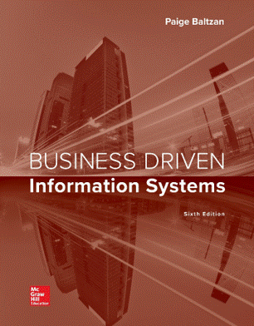
MIS 311: Information Systems
Patrick Shannon
Guest Lecturer: Ron Welch
Notes:
Today we are going to cover Appendix D; Technologies Shaping our Future.

Slide 2

Our world today
Notes:
Key skills for an uncertain future: 1) Critical Thinking, 2) Creativity and 3) Problem Solving along with a fearless attitude (with no fear of failure) meaning you are constantly trying new things. Remember; the one that does the most experiments in life wins!

Slide 3


Slide 4
“We wanted flying cars, instead we got 140 characters.”
Peter Thiel - Founder of PayPal. Entrepreneur, Venture Capitalist, Futurist
Notes:
Why would a company use computer simulation?
What if analysis is a powerful tool
A company that can determine all of the different scenarios associated with a what if analysis is best prepared to deal with the future
Why would a company use historical analysis?
Looking at the past helps us understand what is occurring today

Slide 5
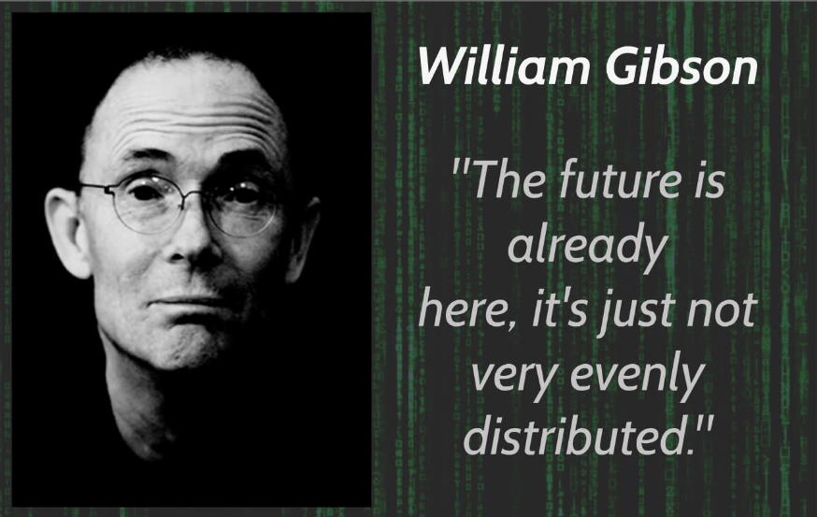
William Gibson – Author, Futurist. Coined the term “cyberspace”
Notes:
Why would a company use computer simulation?
What if analysis is a powerful tool
A company that can determine all of the different scenarios associated with a what if analysis is best prepared to deal with the future
Why would a company use historical analysis?
Looking at the past helps us understand what is occurring today

Slide 6


Introduction
Obtaining a broad view of emerging trends and new technologies as they relate to business can help an organization anticipate and prepare for the future
Organizations that can most effectively grasp the deep currents of technological evolution can use their knowledge to protect themselves against sudden and fatal technological obsolescence

Slide 7




Top Reasons to Study Trends
Generate ideas and identify opportunities – Find new ideas and innovations by studying trends and analyzing publications.
Identify early warning signals – Scan the environment for potential threats and risks.
Gain confidence – A solid foundation of awareness about trends can provide an organization with the confidence to take risks.
Beat the competition – Seeing what is coming before others can give an organization the lead time it requires to establish a foothold in the new market.
Notes:
What impact has technology has on the top reasons to study trends?
Try to identify a company or product that has used technology for each reason.Technology has had an impact on every reason
Technology offers new products and new opportunities such as Apple’s iPhone
Hurricane Katrina devastated the country and there is now a great deal of resources focused on early identification of hurricanes as well as the development of advanced weather monitoring and control systems
Being confident in today’s technological environment is not an easy task. There are a few companies that are confident in their products and are investing billions such as Apple’s iPod, Marks & Spencer's use of RFID, and Microsoft’s Live product line.
Wal-Mart and Dell’s use of supply chain management is the best example when it comes to beating the competition
Steve Jobs noticed the trend of MP3 songs and built the iPod
Polaroid is a great example of a company that focused on the now, the Polaroid camera, and missed the future, the digital camera, and went bankrupt
With SCM organizations must understand the entire supply chain horizontally, not just their vertical focus
It is probably more difficult to achieve this task than at any other time in the history of the world since the business environment is changing so frequently

Slide 8



Top Reasons to Study Trends, cont’d
Understand a trend – Analyzing the details within a trend can help separate truly significant developments from rapidly appearing and disappearing fads.
Balance strategic goals – Thinking about the future is an antidote to a “profit now, worry later” mentality that can lead to trouble in the long term.
Understand the future of specific industries – Organizations must understand everything inside and outside their industry.
Prepare for the future – Any organization that wants to compete in this hyperchanging world needs to make every effort to forecast the future.

Slide 9

Strategies for Spotting Trends
Trend analysis – The examination of a trend to identify its nature, causes, speed of development, and potential impacts
Trend monitoring – Trends viewed as particularly important in a specific community, industry, or sector are carefully monitored, watched, and reported to key decision makers
Trend projection – When numerical data are available, a trend can be plotted to display changes through time and into the future
Notes:
Why would an organization want to perform all of the above?
Trend analysis focuses on past trends
Tend monitoring focuses on present trends
Trend projection focuses on future trends
It helps to understand what has happened and what is happening in order to predict what might happen in the future.
Organizations must watch the past, present, and future to run a successful business.

Slide 10
Strategies for Spotting Trends, cont’d
Computer simulation – Complex systems can be modeled by means of mathematical equations and different scenarios can be run against the model to determine “what if” analysis
Historical analysis – Historical events are studied to anticipate the outcome of current developments
Notes:
Why would a company use computer simulation?
What if analysis is a powerful tool
A company that can determine all of the different scenarios associated with a what if analysis is best prepared to deal with the future
Why would a company use historical analysis?
Looking at the past helps us understand what is occurring today

Slide 11

There is something even more interesting and valuable than trends though…
Notes:
Why would a company use computer simulation?
What if analysis is a powerful tool
A company that can determine all of the different scenarios associated with a what if analysis is best prepared to deal with the future
Why would a company use historical analysis?
Looking at the past helps us understand what is occurring today

Slide 12
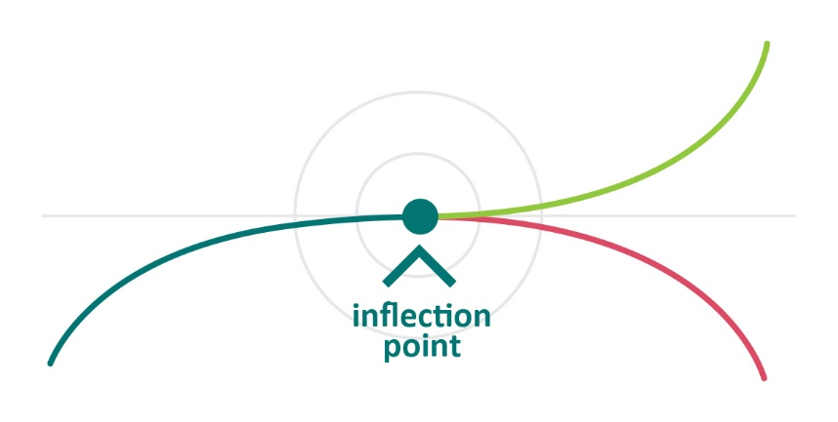
Radical Change: when Trends converge
Notes:
Inflections happen when the near future is radically different from the recent past. Disruption.
Trends are relatively easy to observe, follow and project using the tools we have already discussed. Inflection points are harder to spot and therefore provide unique, potentially huge opportunities. Trends are always present. Inflection points are distinct events.
Individual trends have relatively minor impact. Over time, as multiple trends converge, we get disruption at inflection points.

Slide 13
Individual trends have relatively minor impact initially. But over time, as multiple trends converge, secondary effects accumulate and we get significant disruption at inflection points.
Trend Lifecycle Phases

Slide 14

The 30 Year Cycle for Inflections
Discoveries result in new inventions
Creates entrepreneurs but little widespread impact
Ecosystems begin to emerge
Secondary inventions converge and create new business models
New business models drive large scale growth

Slide 15
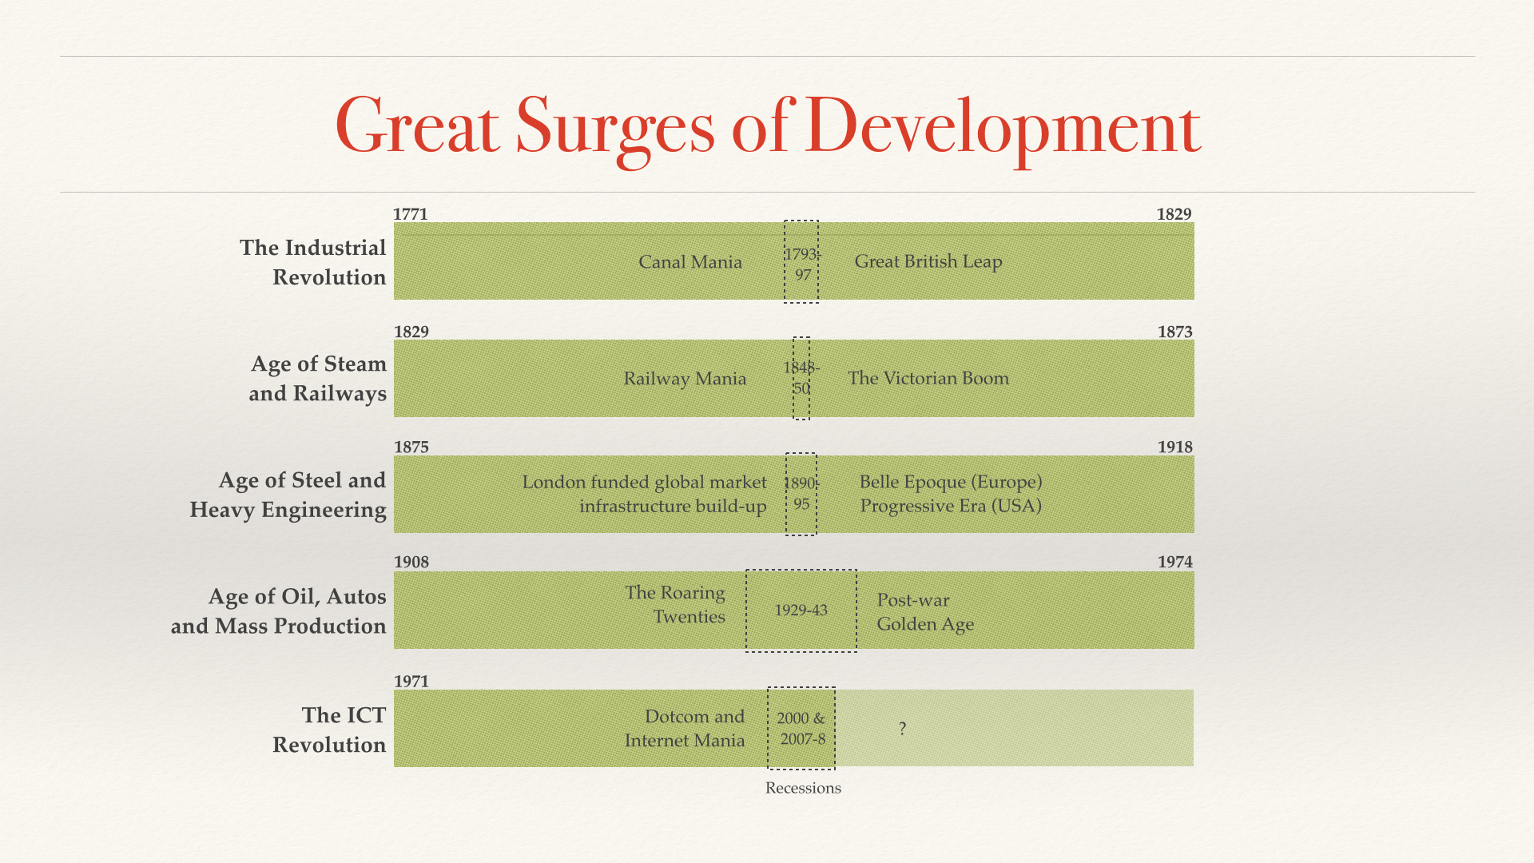
Technological Surges over the last 250 Years
Technological Revolutions and Financial Capital: The Dynamics of Bubbles and Golden Ages - Carlota Perez (2002)

Slide 16
Inflections - Signs to Look for
A Lack of Dissenting Opinions
Everyone is heading in the same direction
Group Think
Example: Housing crisis
Extrapolation of current trends leads to absurd conclusions
Example: Out of whack evaluation – Internet Bubble
Vast changes in cost structures
Example: Newspapers profits are evaporating due drop in cost of distribution dropping to essentially zero

Slide 17

Are we near an inflection point today?
Even if we are years away, an inflection in the span of your careers is virtually inevitable.
So what are the trends that might come together and cause an inflection?
Notes:
I have already identified three trends that I think have the best chance of resulting in an inflection. I will tell my thoughts, then wrap up with time for questions.

Slide 18
Inflection Trend 1
New Computing Architectures to Enable Artificial Intelligence, Machine Learning and the Blockchain
Moore’s law is reaching physical limits
Quantum Computing is showing promise
Could massively impact cryptography
Neuromorphic Architectures
Evolution of GPUs
Optimized for Artificial Neural Networks enabling machine learning
Web 3.0
IPFS, dfinity, Etherium 2.0, Solana, Polkadot, Cardano etc
Notes:
Moore's Law asserts that the number of transistors on a microchip doubles about every two years, though the cost of computers is halved.
IBM is making massive investments in Quantum computing. Showing some good progress.

Slide 19
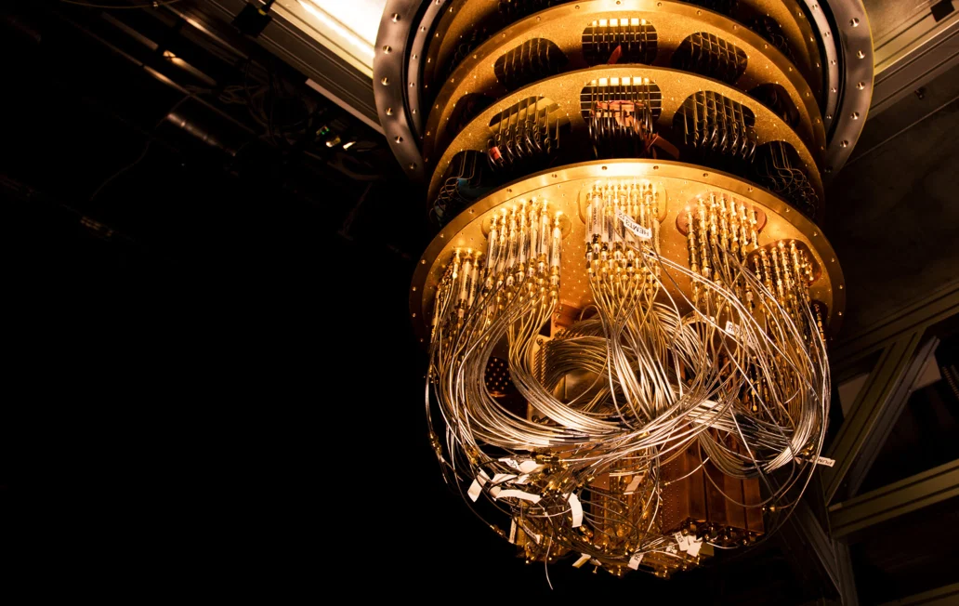
The quest for quantum-proof encryption just made a leap forward
August 3, 2020 - MIT Technology Review
https://www.technologyreview.com/2020/08/03/1005891/search-for-quantum-proof-encryption-computing-nist

Slide 20
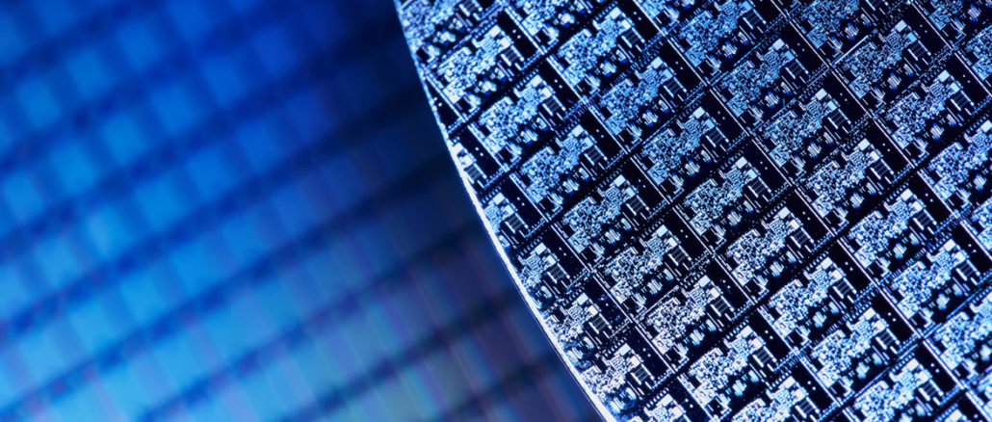
Gutting Decades of Architecture to Build a New Kind of Processor
July 12, 2021 - The Next Platform
https://www.nextplatform.com/2021/07/12/gutting-decades-of-architecture-to-build-a-new-kind-of-processor/

Slide 21
Inflection Trend 2
Synthetic Biology and Genetics
Human Genome Project completed in 2003
CRISPR discovered in 2012
Enables both read and write access to DNA
Combination with Trend 1 is powerful
Biologically engineered materials (synthetic fossil fuels)
DNA based information processing and storage

Slide 22
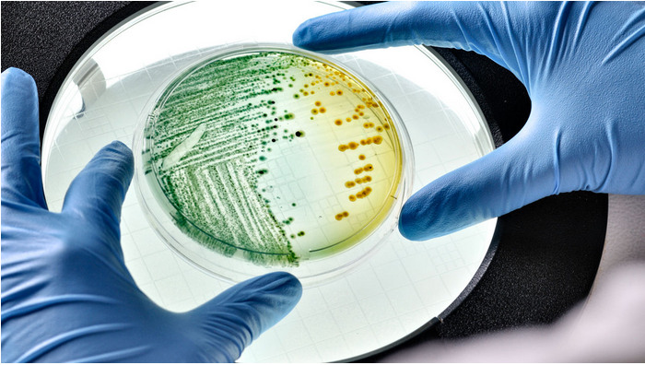
Scientists ‘program’ living bacteria to store data
January 11, 2021 - Science
https://www.sciencemag.org/news/2021/01/scientists-program-living-bacteria-store-data

Slide 23
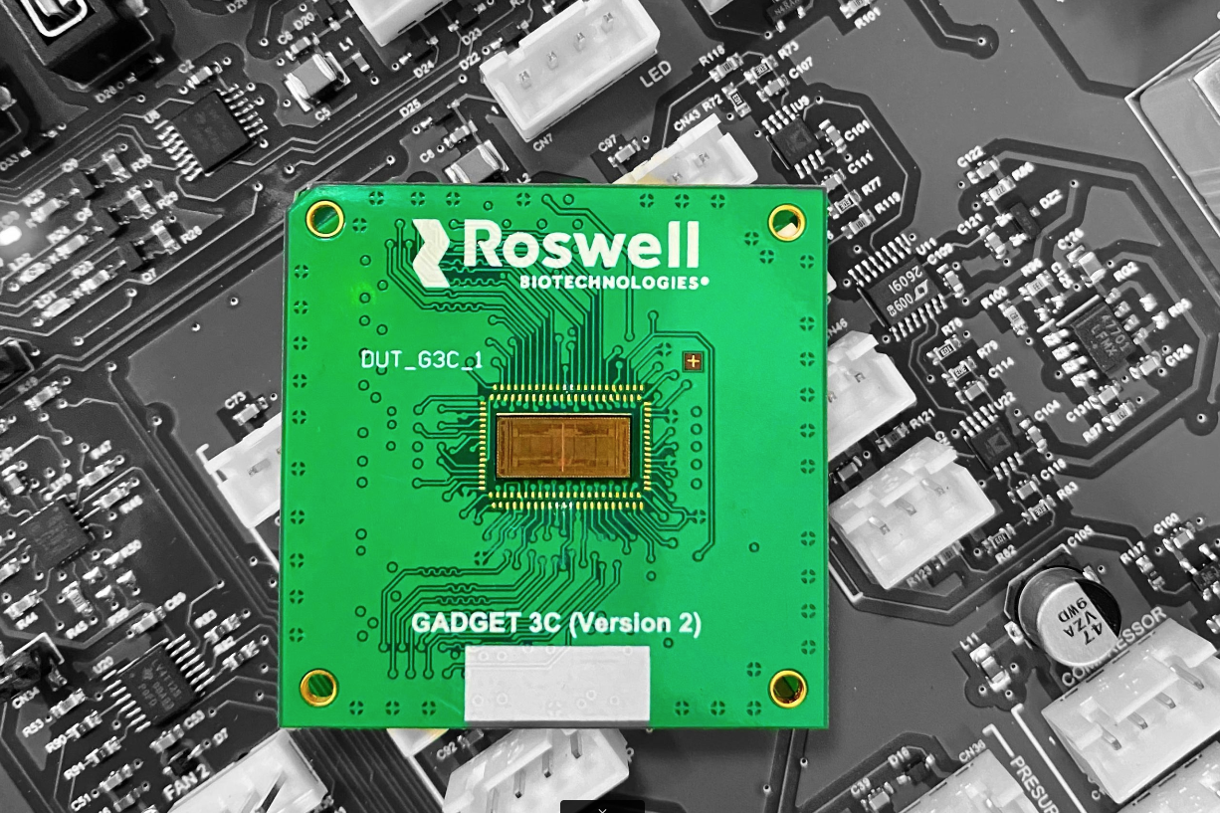
First Molecular Electronics Chip Developed - Realizes 50-Year-Old Goal
January 27, 2022 - SciTech Daily
https://scitechdaily.com/first-molecular-electronics-chip-developed-realizes-50-year-old-goa

Slide 24
Inflection Trend 3
Energy Industry Revolution
Massive Investments are starting to pay off
Price of solar energy is down 70 % in the last decade
Wind and solar are now cheaper than coal in North America (World Economic Forum Report)
Significant impact on developing world
Combination with Trend 1 is powerful
Energy Storage (batteries) remains and issue but machine designed materials are showing promise
Challenges around distribution remain

Slide 25
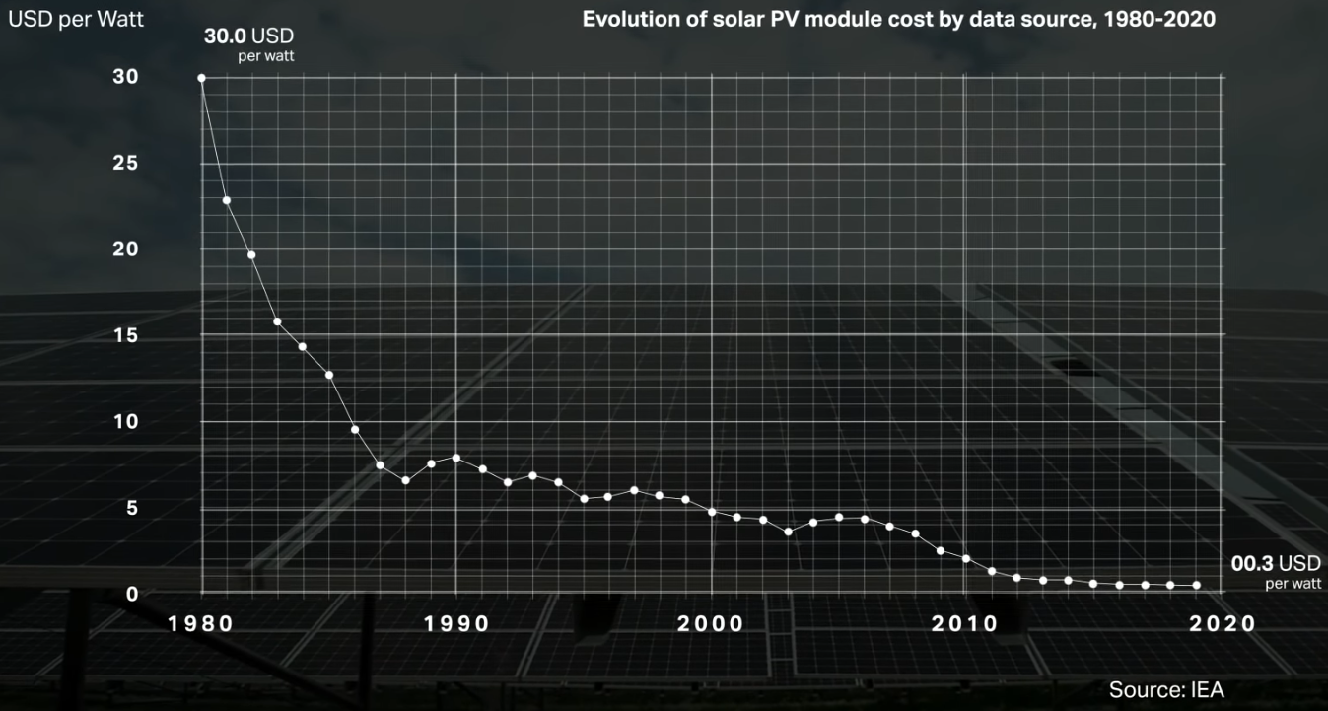

Slide 26
Lithium Ion Batteries Just Made a Big Leap in a Tiny Product
September 8, 2021 - MIT Technology Review
https://www.technologyreview.com/2021/09/08/1035143/sila-whoop-lithium-ion-battery-fitness-wearable-evs

Slide 27
Inflection Trends Ad Infinitum
Nanotechnology
Robotics
Networks and Sensors (5G, IOT etc.)
3-D Printing
Augmented / Virtual Reality
etc

Slide 28
There is something even more interesting and valuable than infection points though…
Notes:
Why would a company use computer simulation?
What if analysis is a powerful tool
A company that can determine all of the different scenarios associated with a what if analysis is best prepared to deal with the future
Why would a company use historical analysis?
Looking at the past helps us understand what is occurring today

Slide 29

Individual inflections disrupt products, services and markets
Convergent inflections wash them away, along with the structures that support them
Notes:
Why would a company use computer simulation?
What if analysis is a powerful tool
A company that can determine all of the different scenarios associated with a what if analysis is best prepared to deal with the future
Why would a company use historical analysis?
Looking at the past helps us understand what is occurring today

Slide 30

Cell Phones + 5G = Massively Distributed Computing
Massively Distributed Computing + AI + Sensors + Quantum = The Internet of Things
Internet of Things + MicroPayments + Blockchain (Privacy) = New Digital Economy
Notes:
Why would a company use computer simulation?
What if analysis is a powerful tool
A company that can determine all of the different scenarios associated with a what if analysis is best prepared to deal with the future
Why would a company use historical analysis?
Looking at the past helps us understand what is occurring today

Slide 31

Evidence of Acceleration
Notes:
Possibilities include: a decentralized financial system with micro-payments being made on your behalf by semi-autonomous agents. A reversal of climate change trends. Drastic increases in life expectancy and quality of life.
But the bottom is that no one really knows.
I picked three convergent trends. I am probably wrong. There are many others.
Its ok to be wrong, that is how you learn. What is important is to pick a star to aim at, and move toward it enthusiastically while at the same time keep a clear, honest eye on the world so you can adapt to change.
Ultimately, what the future looks like is up to your generation. I believe you guys are up to the task.

Slide 32
Energy Harvesting Card Treats 5G Networks as Power Grids
March 28, 2021 - New Atlas
A team from Georgia Tech has just announced a world-first: a 3D-printed rectifying antenna the size of a playing card that can harvest electromagnetic energy from 5G signals and use it to power devices, turning 5G networks into wireless power grids.
https://newatlas.com/energy/5g-energy-harvesting-wireless-power/?utm_source=tldrnewsletter

Slide 33
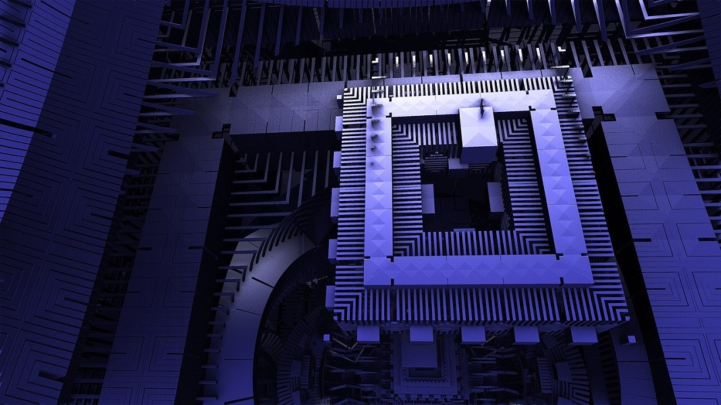
How Quantum Computers Can Be Used to Build Quantum Computers
October 4, 2021 - Singularity Hub
https://singularityhub.com/2021/10/04/how-quantum-computers-can-be-used-to-build-better-quantum-computers/

Slide 34
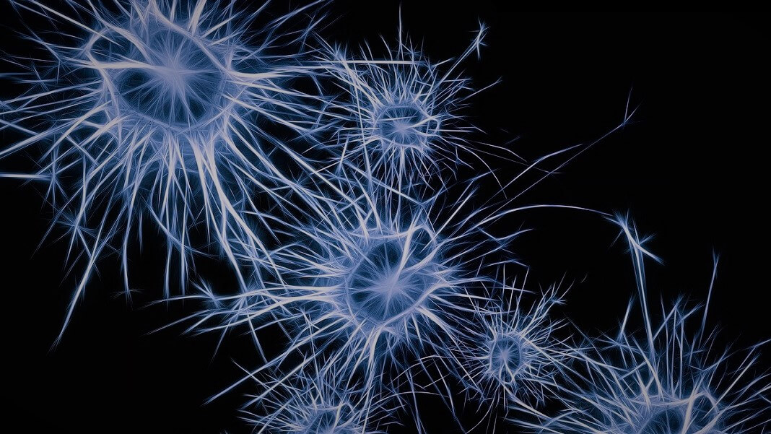
A Nanowire Network That Mimics the Brain Could Inspire new Designs in AI
July 5, 2021 - Singularity Hub
https://singularityhub.com/2021/07/05/a-nanowire-network-that-mimics-the-brain-could-inspire-new-designs-in-ai/

Slide 35
Associated Press Tap Chainlink to Provide Untamperable News Data
October 21, 2021 - Decrypt
https://decrypt.co/83867/associated-press-ap-chainlink-news-data

Slide 36
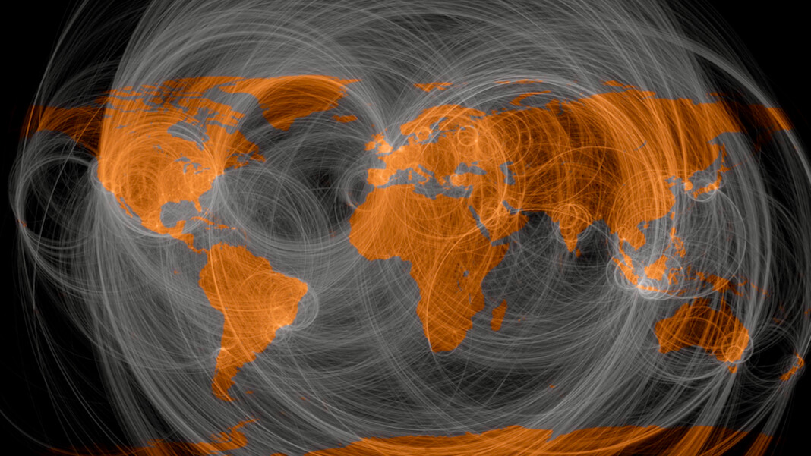
How to Embed Trust into the Foundations of the Internet
September 19, 2021 - SingularityHub
https://singularityhub.com/2021/09/19/how-to-embed-trust-into-the-foundations-of-the-internet/

Slide 37
Researchers Successfully Store Data Inside DNA of Living Bacteria
January 15, 2021 - Science Mint
https://sciencemint.com/researchers-successfully-store-data-inside-dna-of-living-bacteria/?utm_source=tldrnewsletter

Slide 38
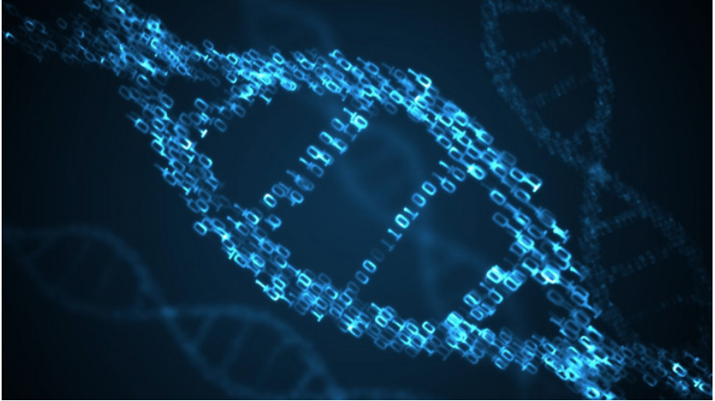
Microsoft’s New Molecular Controller Makes DNA Writing 1,000 Times Faster
December 21, 2021 - Interesting Engineering
https://interestingengineering.com/microsofts-new-molecular-controller-makes-dna-writing-1000-times-faster

Slide 39
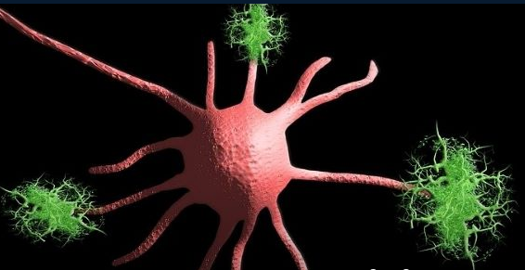
A Massive New Gene Editing Project Out to Crush Alzheimer’s
April 13, 2021 - SingularityHub
https://singularityhub.com/2021/04/13/a-massive-new-gene-editing-project-is-out-to-crush-alzheimers

Slide 40
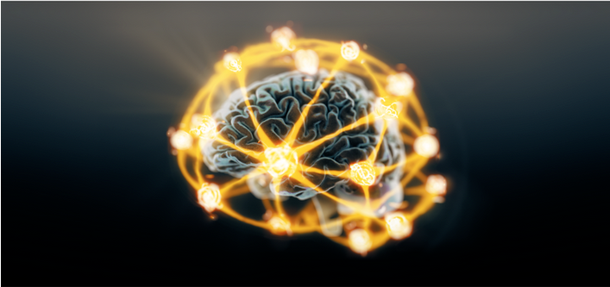
This ‘Quantum Memristor’ Could Enable Brain-Like Quantum Computers
April 4, 2022 - Singularity Hub
https://singularityhub.com/2022/04/04/quantum-memristor-could-enable-quantum-neuromorphic-computing/

Slide 41
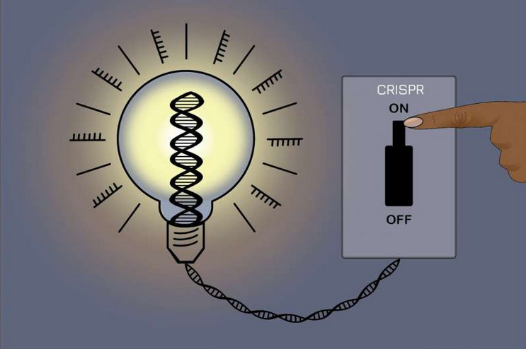
New, reversible CRISPR method can control gene expression while leaving underlying DNA sequence unchanged
April 9, 2021 - SingularityHub
https://phys.org/news/2021-04-reversible-crispr-method-gene-underlying.html

Slide 42
Cell Phones + Solar Power = Battery Technology
Battery Technology + AI + Sensors / Big Data = Machine Learning
Machine Learning + Materials + 3-D Printing = Transportation transformed
Notes:
Why would a company use computer simulation?
What if analysis is a powerful tool
A company that can determine all of the different scenarios associated with a what if analysis is best prepared to deal with the future
Why would a company use historical analysis?
Looking at the past helps us understand what is occurring today

Slide 43
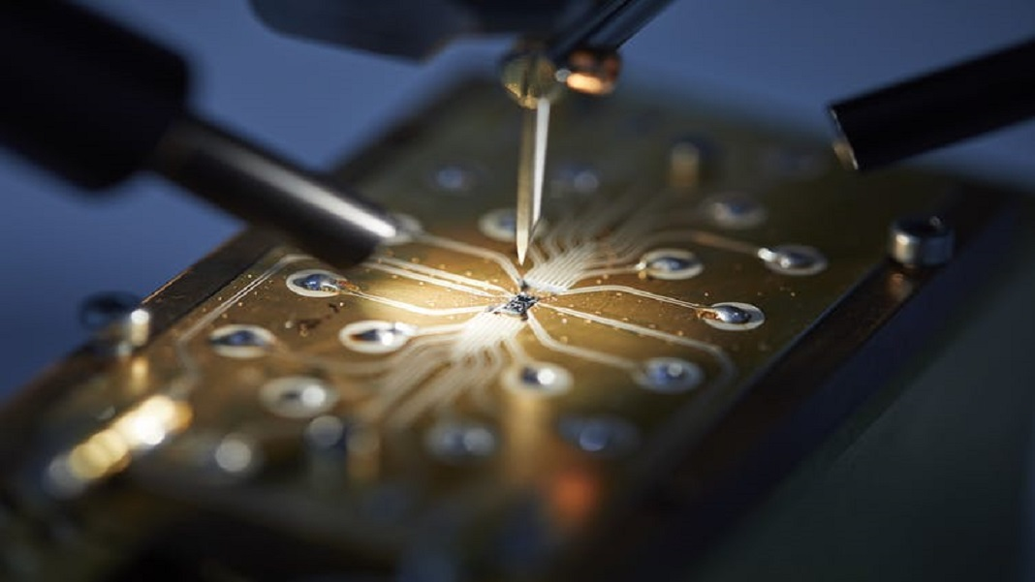
Simple Crystal Could Help Pave the Way to Full Scale Quantum Computing
August 1, 2021 - Singularity Hub
https://singularityhub.com/2021/08/19/how-a-simple-crystal-could-help-pave-the-way-to-full-scale-quantum-computing

Slide 44

AI Is Throwing Battery Development Into Overdrive
October 12, 2020 - Wired
https://www.wired.com/story/ai-is-throwing-battery-development-into-overdrive

Slide 45
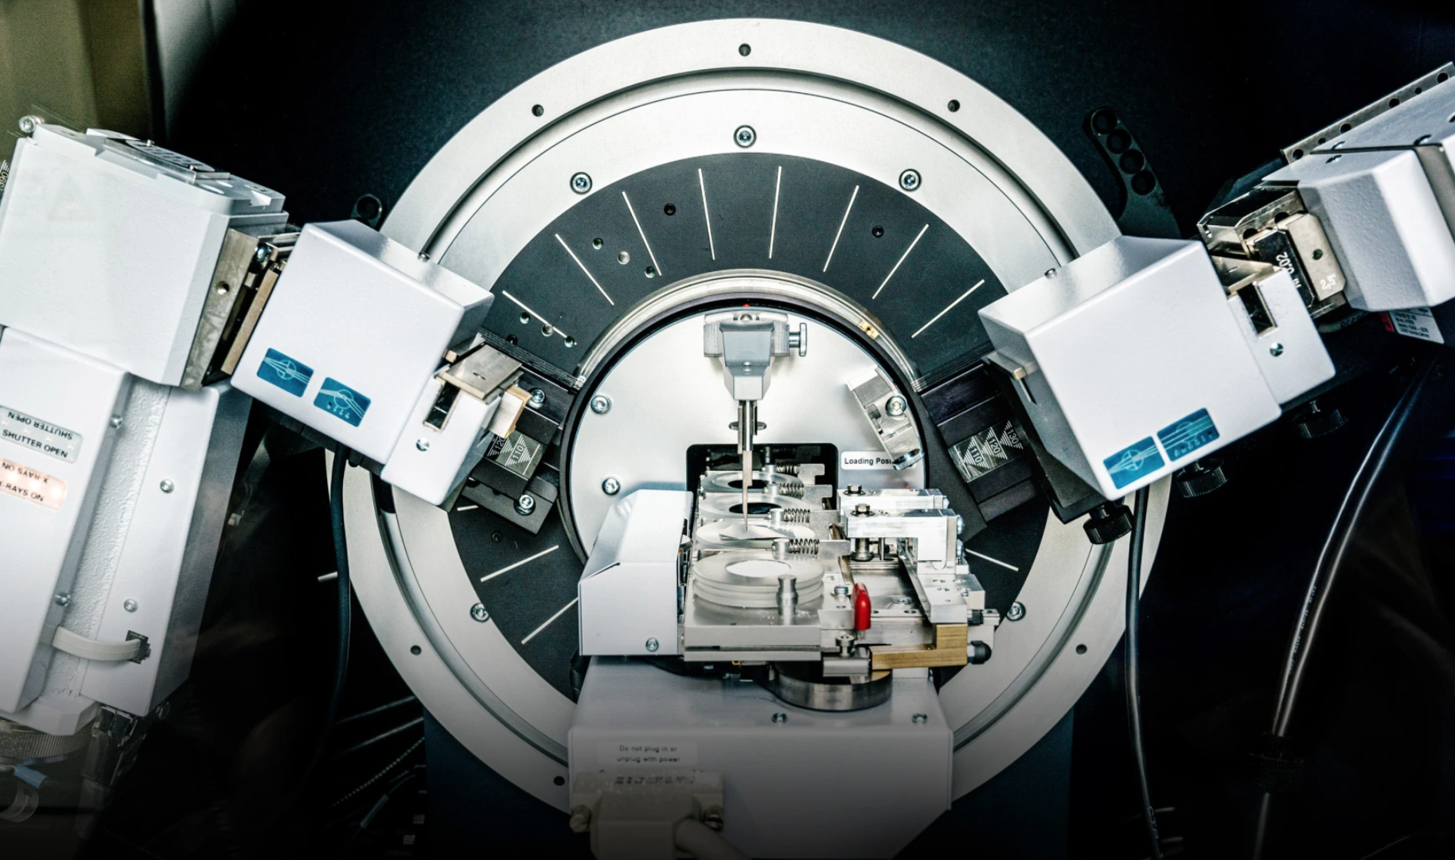
Novel lithium-metal batteries will drive the switch to electric cars
February 24, 2021 - MIT Technology Review
https://www.technologyreview.com/2021/02/24/1018102/lithium-metal-batteries-electric-vehicle-car

Slide 46
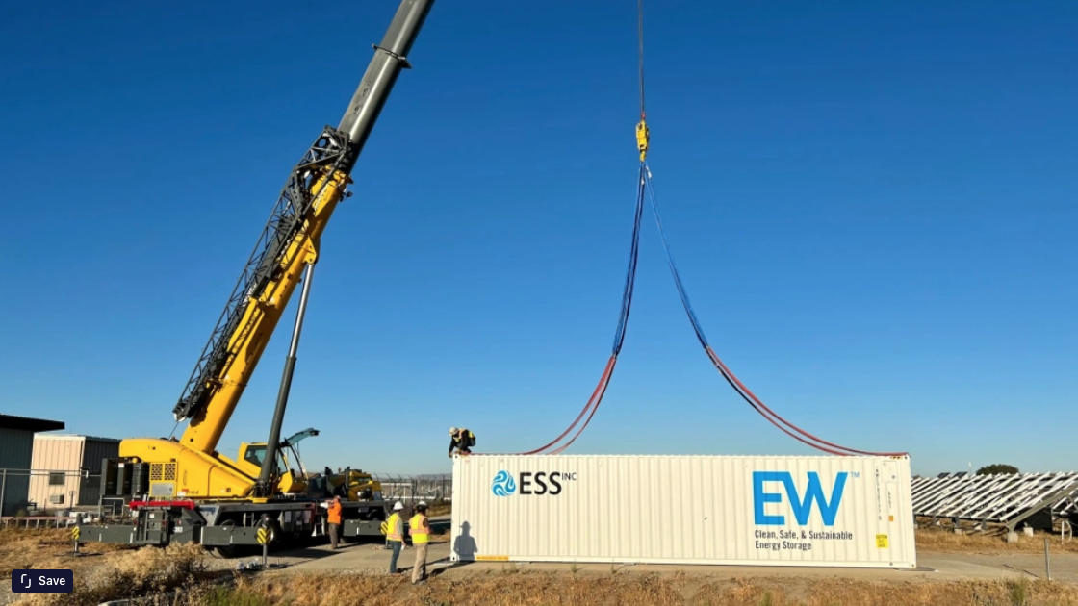
We’re going to need a lot more grid storage. New iron batteries could help.
February 23, 2022 - MIT Technology Review
Flow batteries made from iron, salt, and water promise a nontoxic way to store enough clean energy to use with the sun isn’t shining.
https://www.technologyreview.com/2022/02/23/1046365/grid-storage-iron-batteries-technology

Slide 47
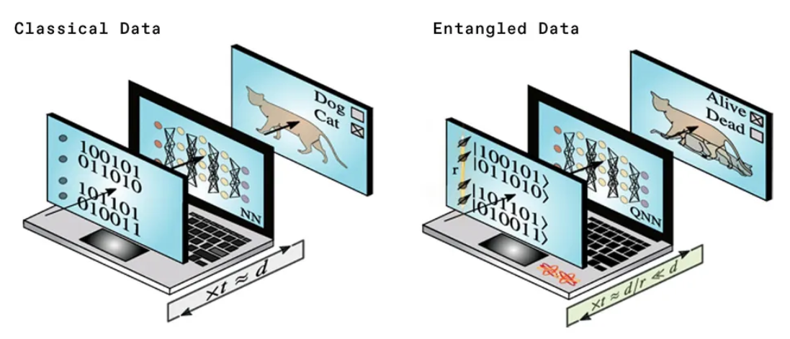
Spooky Action Could Help Boost Quantum Machine Learning
March 7, 2022 - IEEE Spectrum
https://spectrum.ieee.org/quantum-machine-learning

Slide 48
Electric Flying Cars May be Possible with New Batteries
June 15, 2021 - IEEE Spectrum
Lithium-ion cells with nickel foil can handle fast charging and could sustain 80-kilometer flights
https://spectrum.ieee.org/evtol-battery

Slide 49
This Chemist is Reimagining the Discovery of Materials Using AI and Automation
October 27, 2021 - MIT Technology Review
Alan Aspuru-Guzik is using AI, robots, and even quantum computing to create the new materials we will need fight climate change.
https://www.technologyreview.com/2021/10/27/1037114/materials-discovery-ai-chemistry-computing

Slide 50
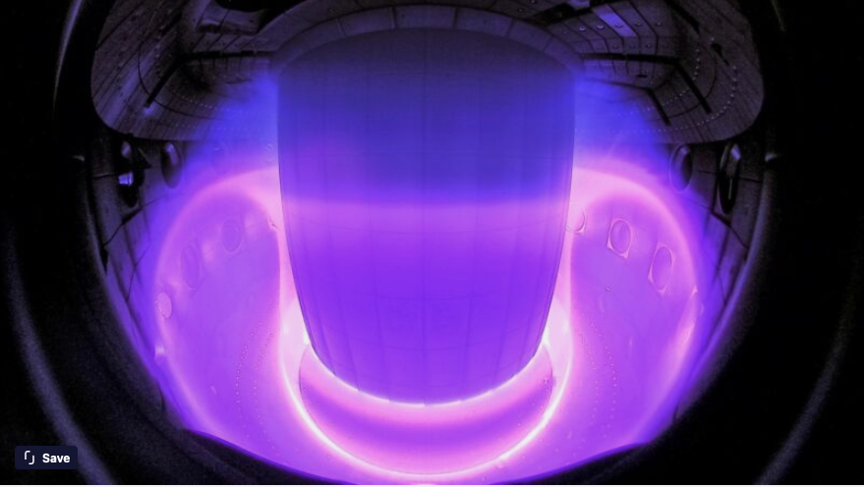
Latest success from Googles AI group: Controlling a fusion reactor
February 16, 2022 - MIT Technology Review
The AI was trained on a simulator to shape the plasma held within a tokamak
https://arstechnica.com/science/2022/02/latest-success-from-googles-ai-group-controlling-a-fusion-reactor

Slide 51
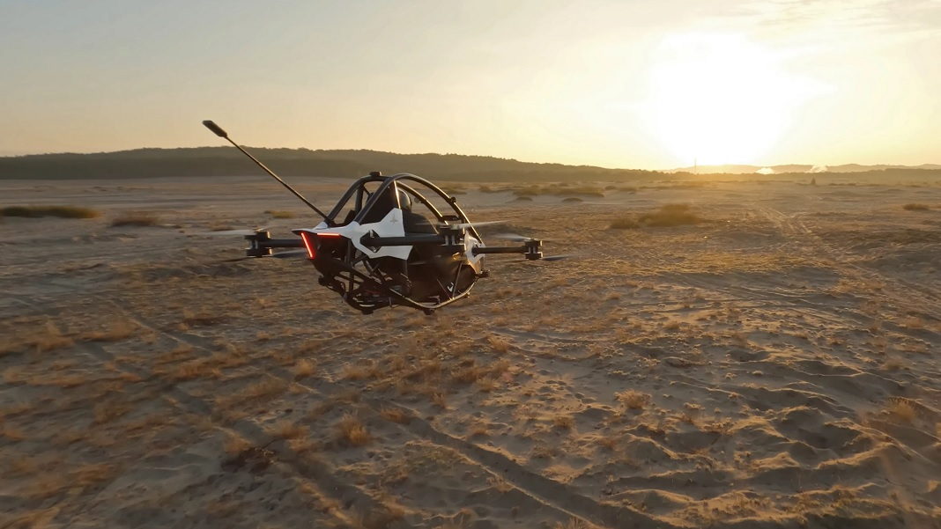
Tiny Personal Aircraft Costs Under $100K and Can Take Off from Your Driveway
October 27, 2021 – SingularityHub
https://singularityhub.com/2021/10/27/this-tiny-personal-aircraft-costs-under-100k-and-can-take-off-from-your-driveway/
Notes:
250 mile range (by air). 150 MPH in the air, 70 MPH on the highway. Hybrid including Hydrogen option planned. $789,000 pre-order now.

Slide 52
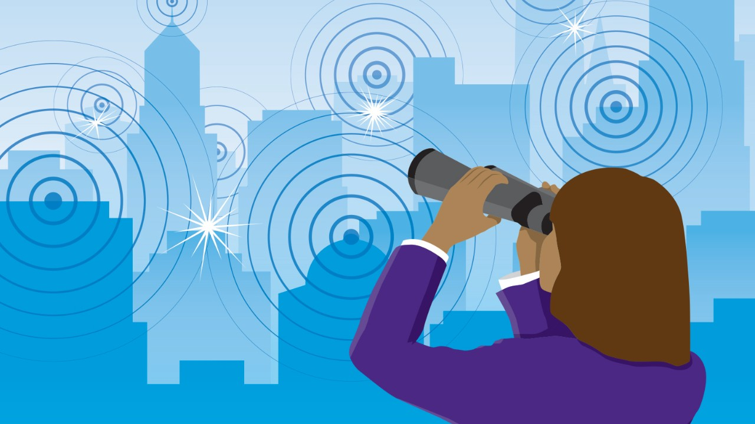
Convergent Inflection points are here
Industry disruption is widespread and rapidly accelerating
Notes:
Possibilities include: a decentralized financial system with micro-payments being made on your behalf by semi-autonomous agents. A reversal of climate change trends. Drastic increases in life expectancy and quality of life.
But the bottom is that no one really knows.
I picked three convergent trends. I am probably wrong. There are many others.
Its ok to be wrong, that is how you learn. What is important is to pick a star to aim at, and move toward it enthusiastically while at the same time keep a clear, honest eye on the world so you can adapt to change.
Ultimately, what the future looks like is up to your generation. I believe you guys are up to the task.

Slide 53


Slide 54
Parting Thoughts

Slide 55
What will the future world look like?
You Get To Decide
Ron.Welch@gmail.com
Notes:
Possibilities include: a decentralized financial system with micro-payments being made on your behalf by semi-autonomous agents. A reversal of climate change trends. Drastic increases in life expectancy and quality of life.
But the bottom is that no one really knows.
I picked three convergent trends. I am probably wrong. There are many others.
Its ok to be wrong, that is how you learn. What is important is to pick a star to aim at, and move toward it enthusiastically while at the same time keep a clear, honest eye on the world so you can adapt to change.
Ultimately, what the future looks like is up to your generation. I believe you guys are up to the task.

